Slide 1
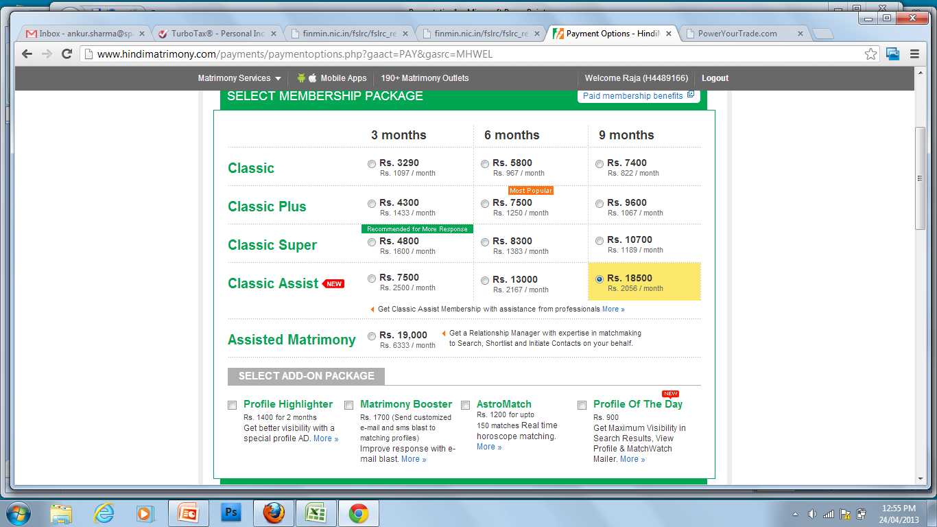
2014 Tax Filing Products for Corporate & Alliance
Who we are
India’s most trusted online tax preparation and filing company
Largest E-Return Intermediary (ERI) authorized by Income Tax Department
Only tax portal having security certified by CERT-IN empanelled consultants
KEY TAX CHANGES RELEVANT TO EMPLOYEES
  E-filing Mandatory
  Every individual who is required to file the tax returns must do so only via the electronic filing of returns
  E-return intermediaries have been authorized by the income tax department to facilitate e-filing
  Income Tax Scrutiny Notices
  ‘Data mismatch’ notices to salaried employees
  ‘Defective ITR’ notices to employees & self-employed
  ‘Non-filing of ITR’ notices to several lakh employees
Our Strengths
Always there for your support
We understand return filing is not ‘file-it-forget-it’ service. Our processes ensure that we are there for you at every step of the way – preparation, filing, assessment, scrutiny, liaison, rectification or refund.
No mis-selling
We do not sell any financial products in the guise of filing ITR. We do not share the data of our customers with any third party. It helps us stay not only clean, but also lean and mean!
Complete solution
We facilitate reconciliation of ITR data with 26AS, e-filing of ITR1, ITR2 & ITR4, service tax compliance, professional assistance for tax filing, tax planning, bookkeeping and audit services. Nobody else does it!
NEW FEATURES AT TAXSPANNER.COM
  Past 5-year Tax Return Status along-with Pending Actions
  To ensure that you never miss any communication related to your Income Tax return, you can now track your complete ITR processing status (for up to 5 years) through TaxSpanner.com
  Track income tax refund status, outstanding tax demand notice, discrepancy notice, pending assessment
  Verified Tax Returns
  Our super-secure APIs access to I-T department database, authorized by ITD for verification, ensures that you always know your transactions available to the ITD. With this information, your tax return can never go wrong!
  Peace of mind tax services (extra charges apply)
  Track Tax Credits – real-time alerts of tax credit for your PAN
  Refund tracking - tracking of your tax refund till it is credited
HOW TO AVAIL THE EFILING SERVICE
  SAP employees, go to http://www.taxspanner.com/reference/sap
SPECIAL 2014 OFFER FOR SAP EMPLOYEES*
Services & scope
Salary eFile Plus – Self E-file (Rs. 299)
Full 5-year tax report with status of tax returns and pending actions
All returns are Verified (matched with ITD database) prior to e-filing
Special 55% discount for corporate with significant employee size
Email based assistance (24 hr TAT)
Includes drop-box pickup of ITR-V
Salary eFile Plus – Assisted (Rs. 400)
All returns are Verified
Complete Assistance – capital gains, multiple Form 16, complex salary returns
Return is prepared by tax experts
Self E-file
HelpDesk
Standard
E-filing of ITR without matching ITR data with transactions in I-T Dept database (Online unverified ITR).
Rs. 249
Spl: Rs. 199
Spl: Rs. 250
Plus (default)
Verified E-filing of ITR after matching with ITD database.
Full 5-year tax report with return status and pending actions.
Rs. 449
Spl: Rs. 299
Spl: Rs. 400
Why Plus package is recommended & is the default package?
All the financial transactions of the individuals are under the lens of the income tax department. Matching of your ITR data with the transactions database of ITD, prior to e-filing, is called verification of ITR. Such returns are called Verified Tax Returns. Verified returns eliminate the chances of receiving notice due to data mismatch with Form 26AS.
  * Discounted prices applicable till July 20, 2014 only. Service Tax extra

Slide 2
5 Reasons to choose TaxSpanner.com
1
Income Tax department knows it all
We make sure that you do not leave anything in your ITR by chance or due to ignorance. Our access to the I-T department database ensures that your return is in accordance to the information available with ITD, so that your tax return filed through TaxSpanner.com can never go wrong!
2
Only company to offer Verified Returns
TaxSpanner.com is the only tax website to offer verified returns, matching ITR data with the data already known to Income Tax Department. You can not go wrong with us!
3
Return filing is no longer File-IT-Forget-IT
We are always there to support you. Our processes ensure that we are there for you during – preparation, filing, assessment, scrutiny, liaison, rectification or refund.
4
Track your income tax or refund status
Now you can track any outstanding demand raised by department, discrepancy notice, ITR processing status, and refund status with TaxSpanner.com.
5
Data Privacy & Confidentiality First
As the largest E-return Intermediary of the income-tax department, we strictly adhere to the legal guidelines of data privacy, as mandated in the intermediary license.

Slide 3

The Way we Work
Our principles
Integrity: We conduct our business with integrity.
Customers' interests: We pay due regard to the interests of our customers and treat them fairly.
Communications with clients: We pay due regard to the information needs of our clients, and communicate information to them in a way which is clear, fair and not misleading.
Conflicts of interest: We ensure that there is no conflict of interest built into our online solutions or the information we provide.
Customers relationships of trust: We take care to ensure the suitability of our tools for any customer who is entitled to rely upon its judgment.
Why do lakhs of taxpayers choose TaxSpanner for their tax compliance over other services?
It’s not just because we are rated as the finest, but also because we never sell your data. TaxSpanner.com is the only website certified by the Cert-in empanelled consultants. It certifies that your tax data is completely secure from any vulnerabilities.
Moreover, TaxSpanner is authorized as the E-Return Intermediary by the Income Tax Department. We have been appreciated for being the single largest tax e-filing company in India.

